Slide 1

Portada
Notes:
textbox
No alt text provided

Slide 2
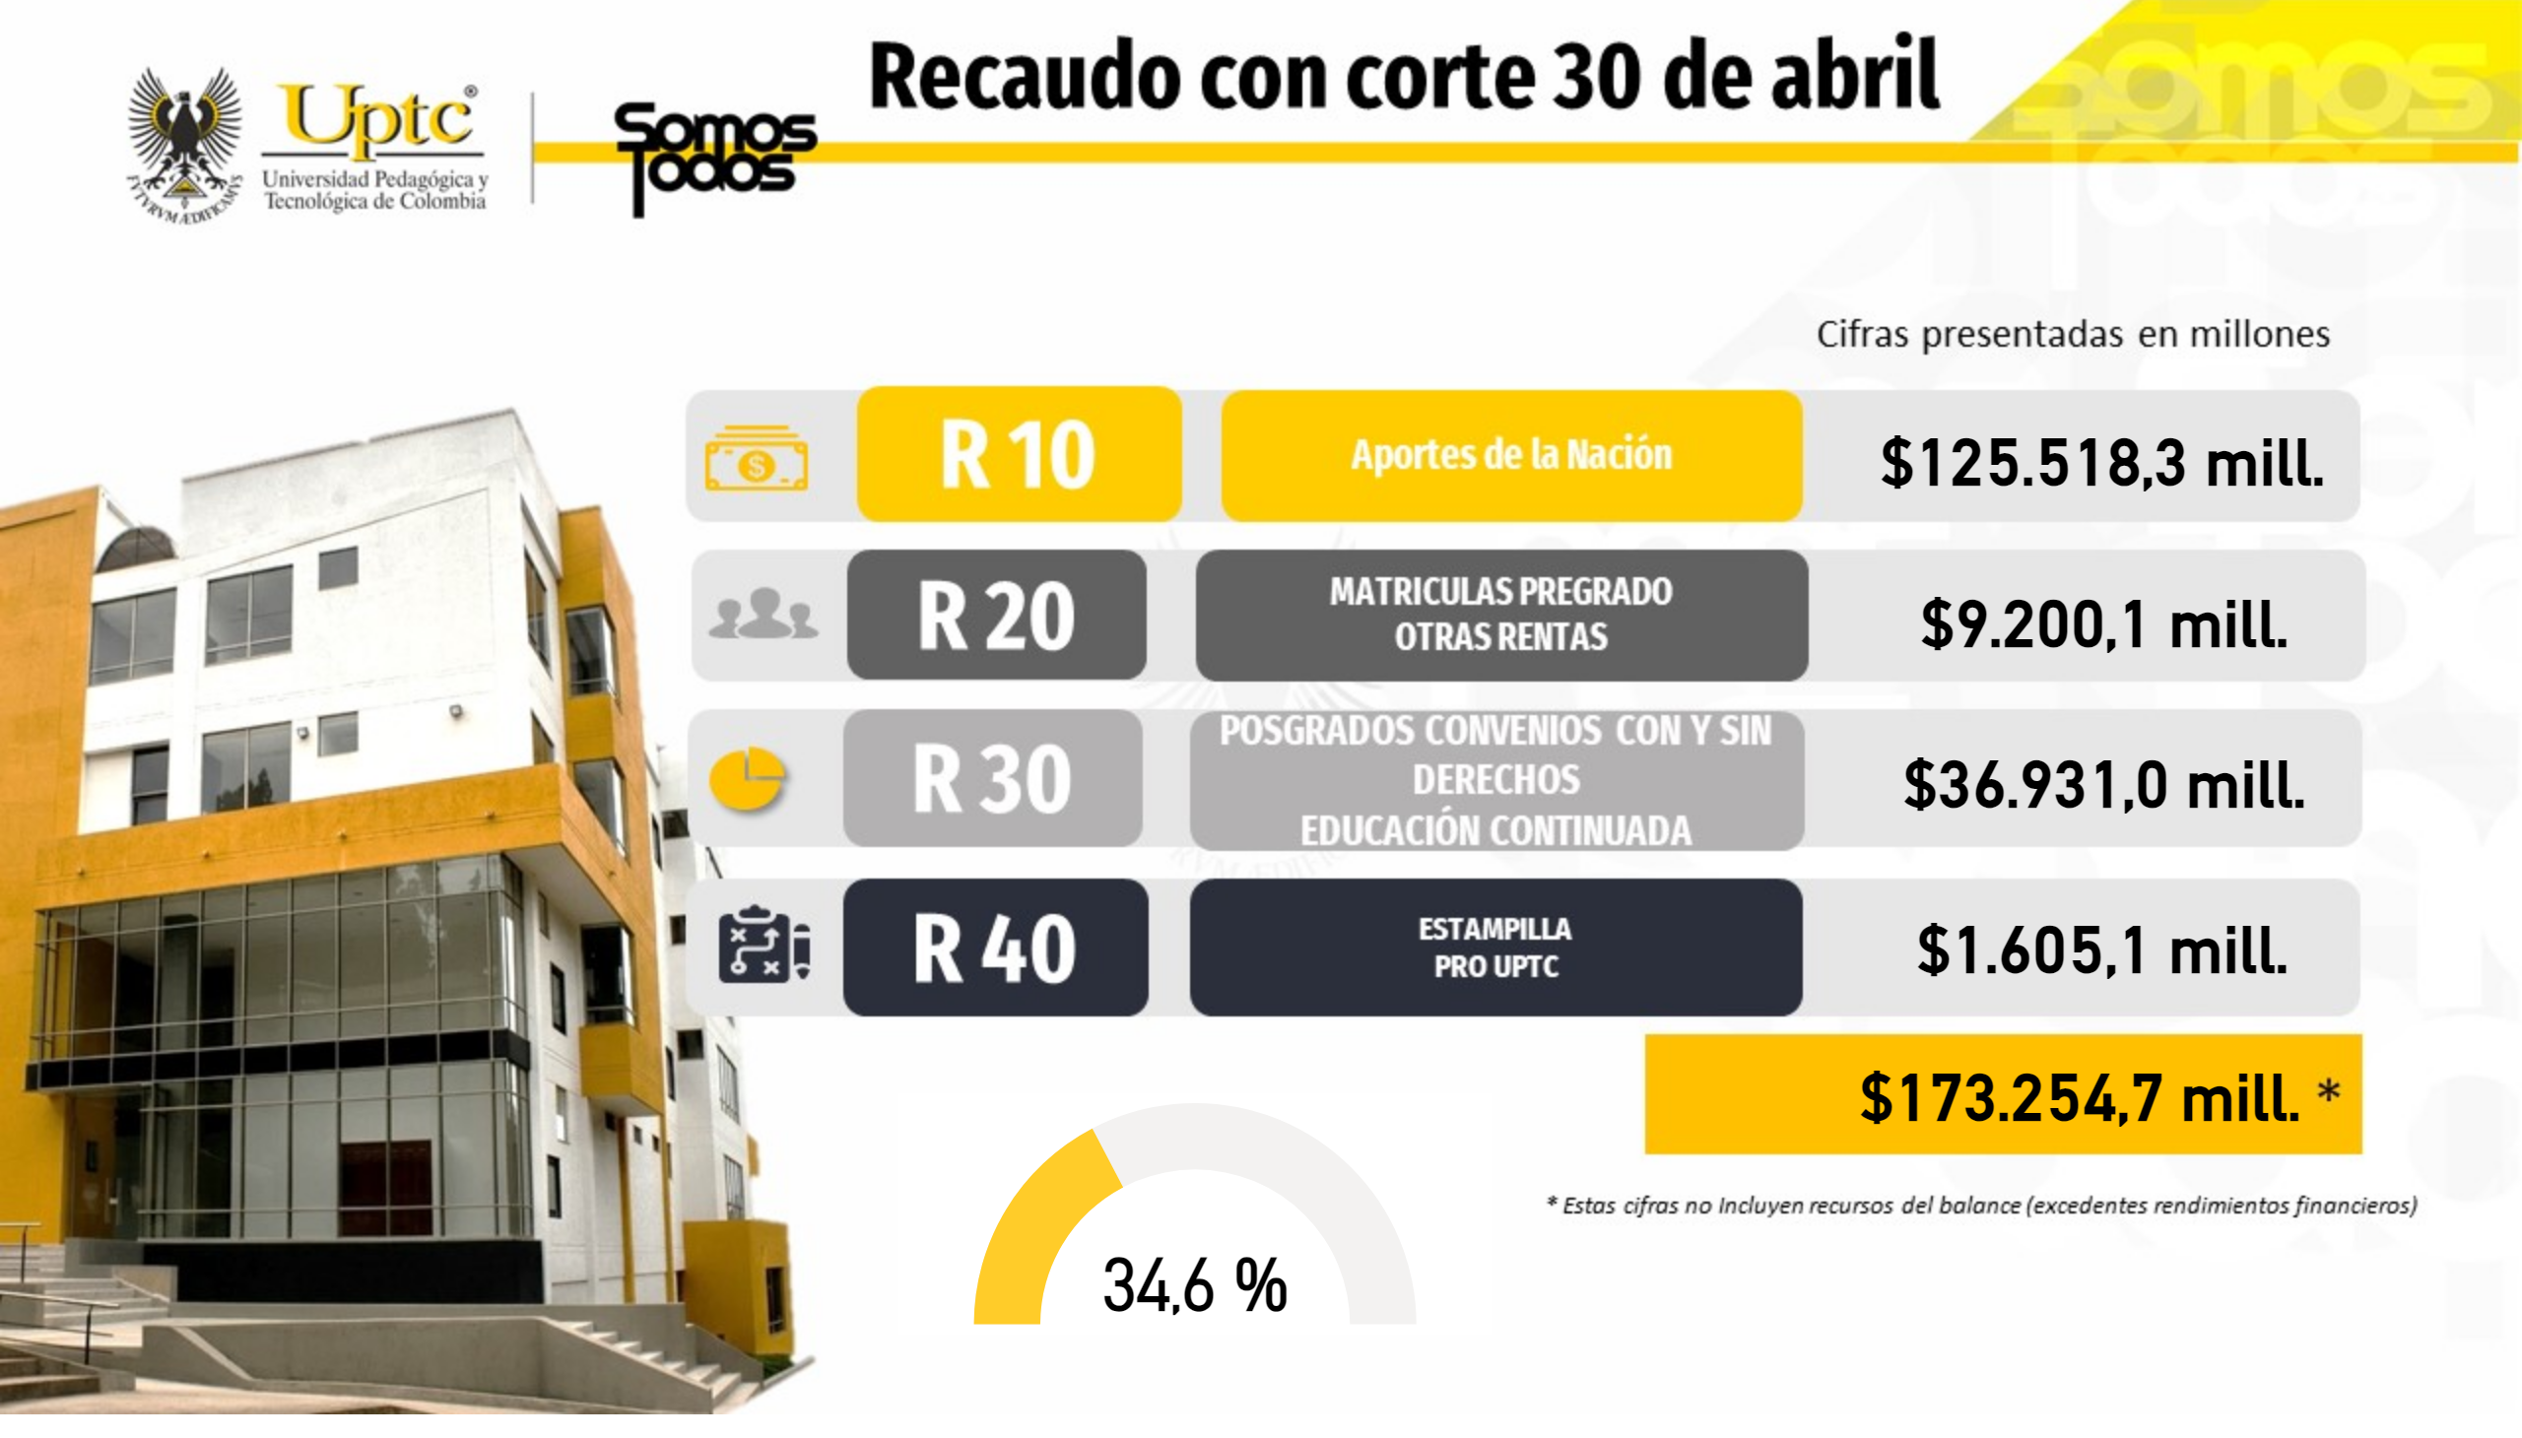
Ingresos
Notes:
Valor Inicial
No alt text provided
Valor Inicial
No alt text provided
Valor Inicial
No alt text provided
Valor Inicial
No alt text provided
gauge
No alt text provided
Valor Inicial
No alt text provided

Slide 3
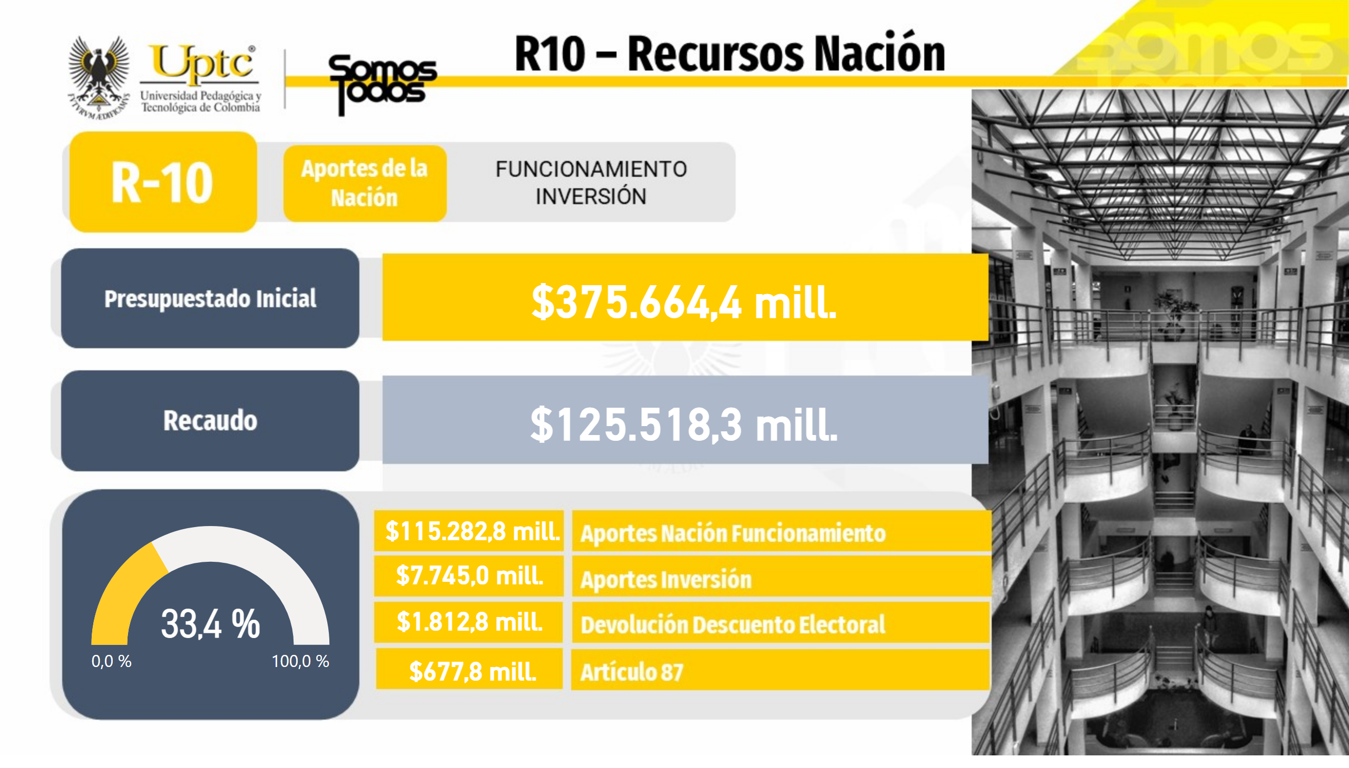
R10
Notes:
Valor Inicial
No alt text provided
gauge
No alt text provided
Valor Inicial
No alt text provided
Valor Inicial
No alt text provided
Valor Inicial
No alt text provided
Valor Inicial
No alt text provided
Valor Inicial
No alt text provided

Slide 4
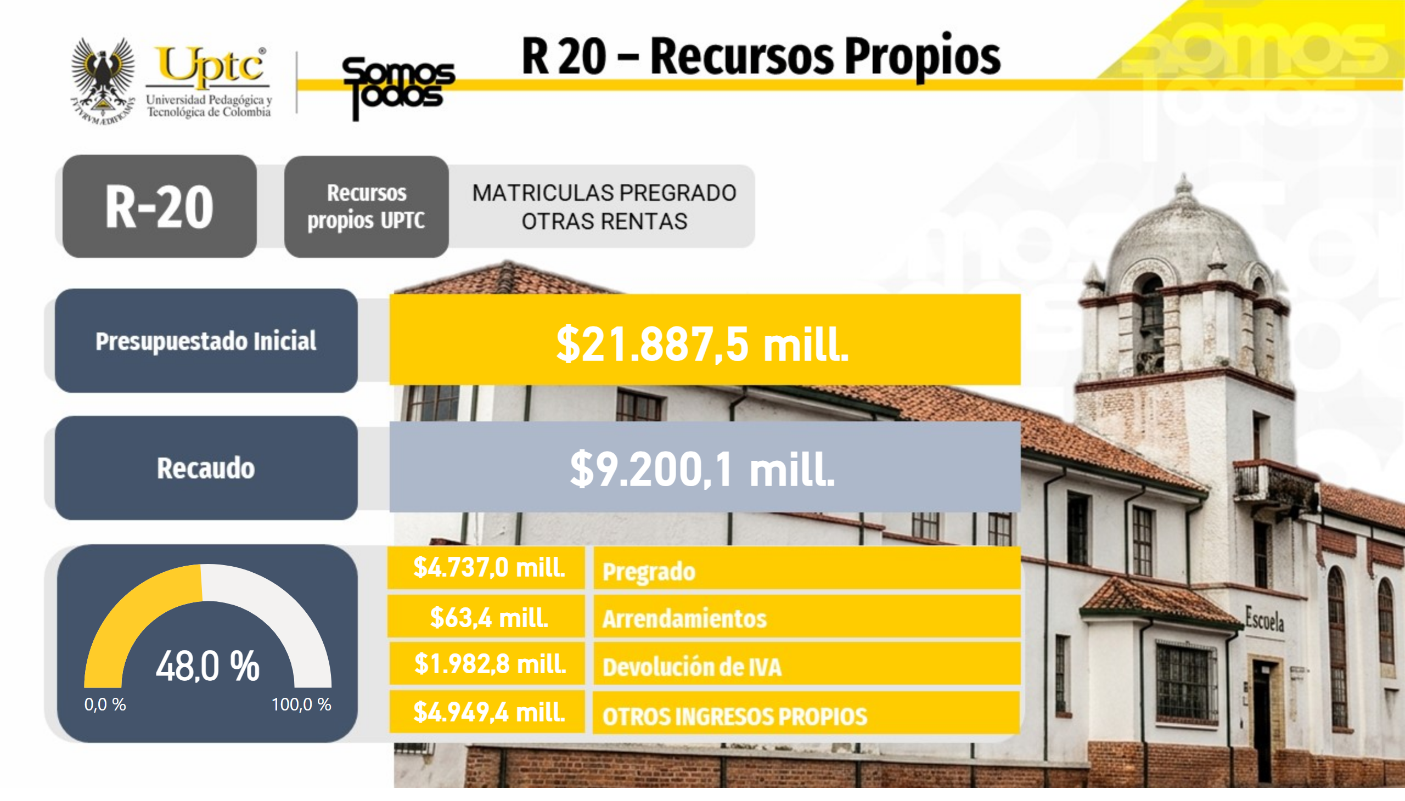
R20
Notes:
Valor Inicial
No alt text provided
Valor Inicial
No alt text provided
gauge
No alt text provided
Valor Inicial
No alt text provided
Valor Inicial
No alt text provided
Valor Inicial
No alt text provided
Valor Inicial
No alt text provided

Slide 5
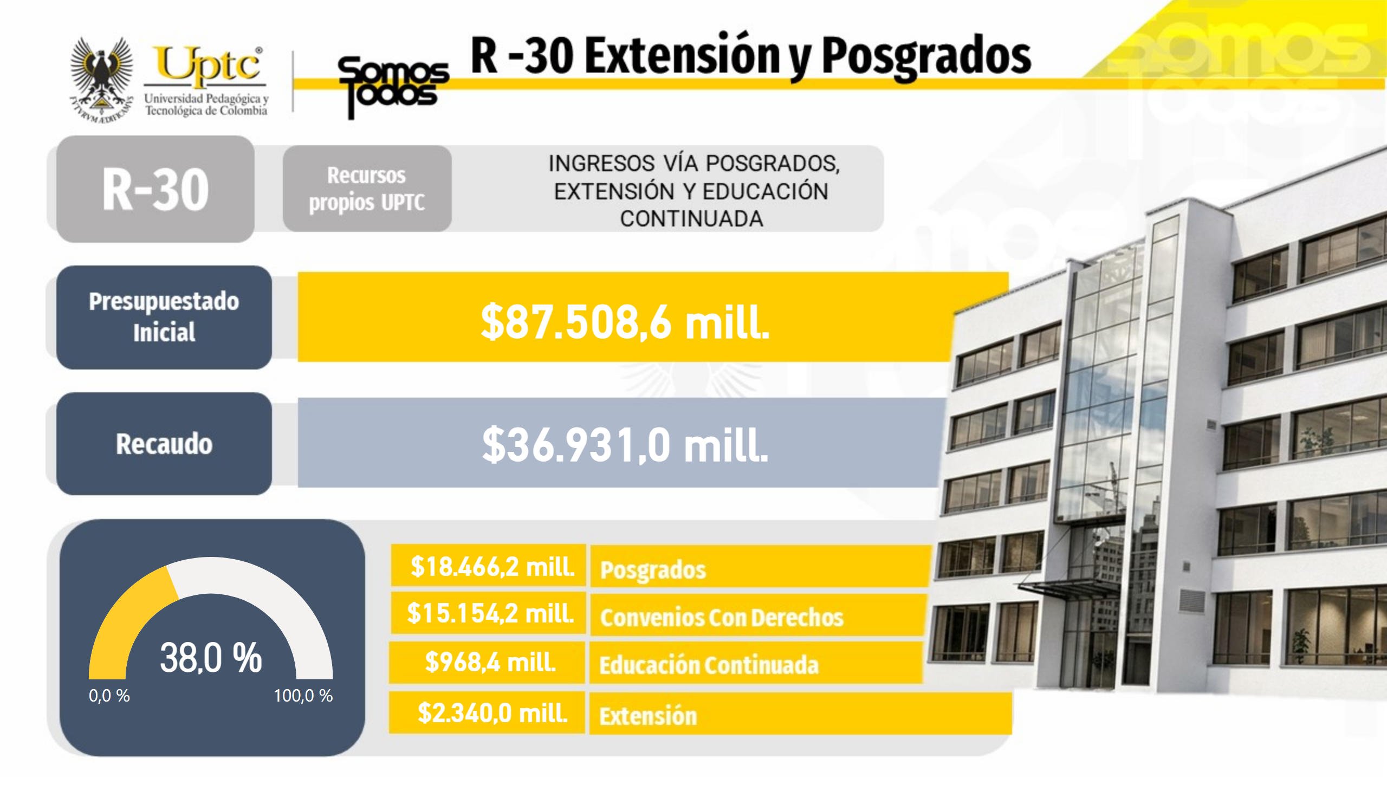
R30
Notes:
Valor Inicial
No alt text provided
Valor Inicial
No alt text provided
gauge
No alt text provided
Valor Inicial
No alt text provided
Valor Inicial
No alt text provided
Valor Inicial
No alt text provided
Valor Inicial
No alt text provided

Slide 6
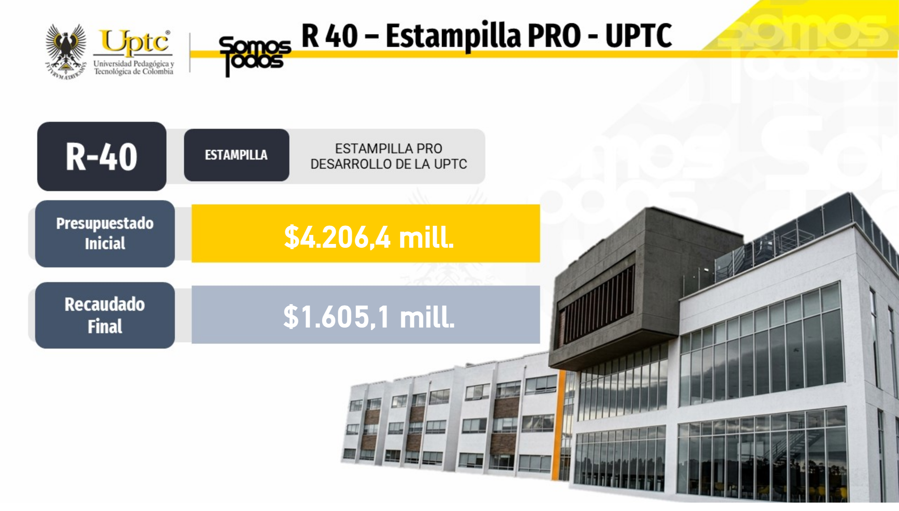
R40
Notes:
Valor Inicial
No alt text provided
Valor Inicial
No alt text provided

Slide 7
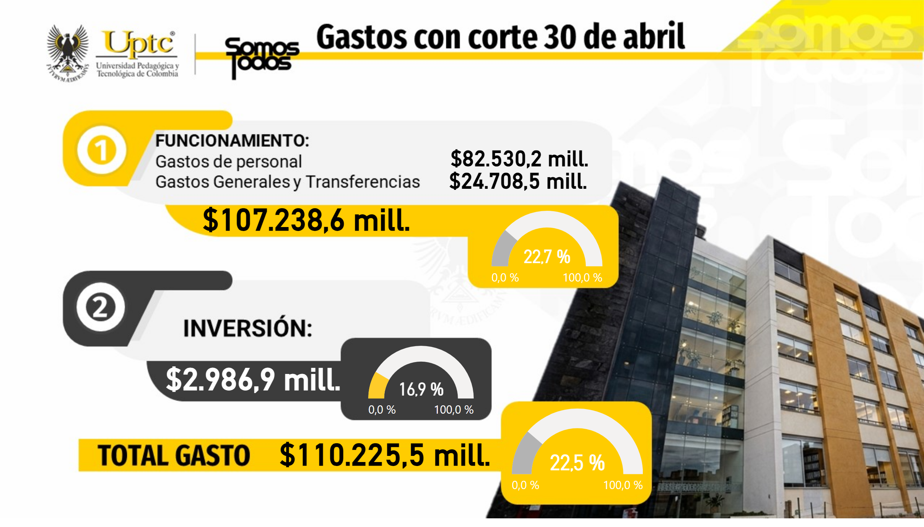
Gastos
Notes:
Valor Inicial
No alt text provided
Valor Inicial
No alt text provided
Valor Inicial
No alt text provided
Valor Inicial
No alt text provided
Valor Inicial
No alt text provided
gauge
No alt text provided
gauge
No alt text provided
gauge
No alt text provided

Slide 8

Diap4
Notes:
textbox
No alt text provided

